Slide 1
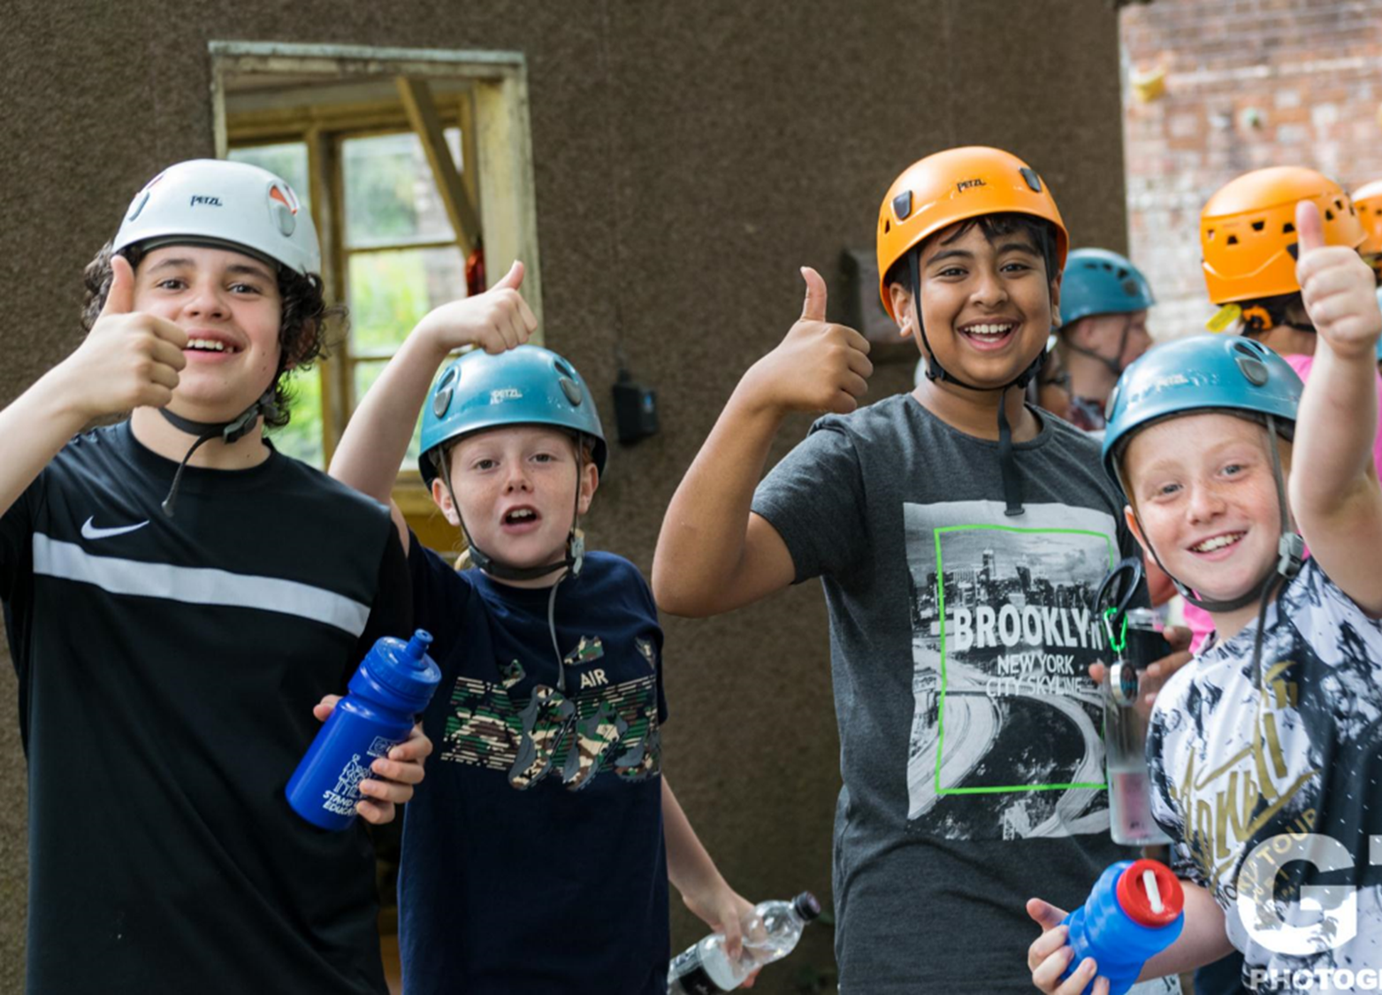
Frank Chapman Outdoor Education Centre
[your date]

Slide 2
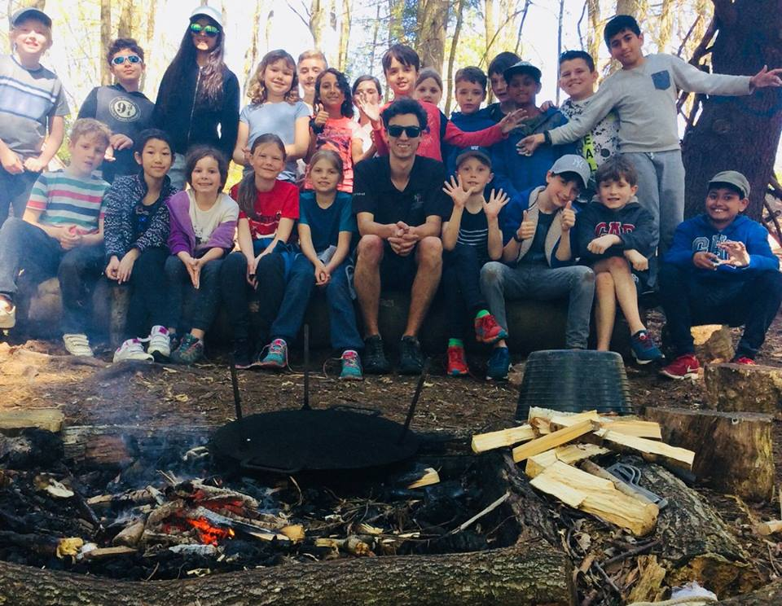
AGENDA
About Sandwell Residential Education Service
Your centre: Frank Chapman
Activities and learning
Teacher & participant feedback
The benefits of residential experiences
Sleeping & eating
Q & A

Slide 3
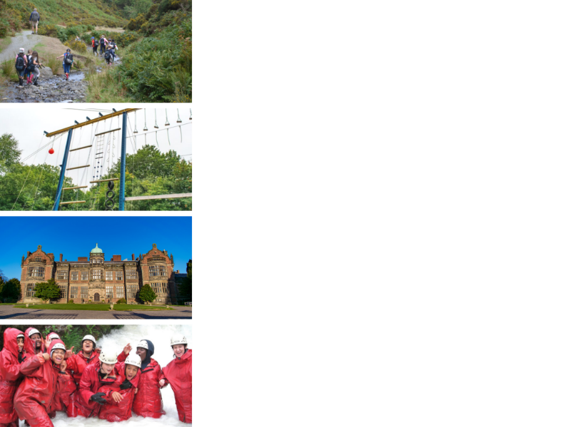
ABOUT SANDWELL RESIDENTIAL SERVICE
4 SUPER VENUES
Edgmond Hall Shropshire
Frank Chapman Centre Wyre Forest
Ingestre Arts Staffordshire
Plas Gwynant Snowdonia
HOME FROM HOME
Small, welcoming centres. Have the place to yourselves!
TAILORED PROGRAMMES
A real learning experience:
The programme is designed with school.
THE HIGHEST STANDARDS
14,000 pax p/a from across the UK

Slide 4
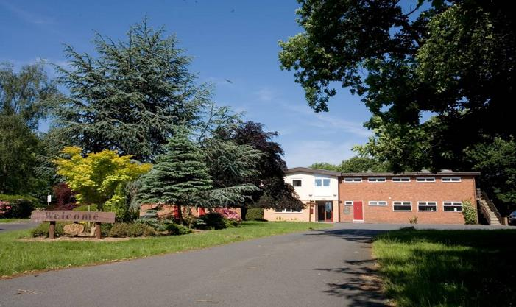
ORCHARD VILLAGE @ FRANK CHAPMAN
Location
The Frank Chapman Centre is situated in the beautiful Wyre Forest, near Bewdley in Worcestershire, DY12 2TY
Outside
The centre has approximately 90 acres of SSSI woodland which includes fields, streams and play areas - plenty of safe space to explore!
Inside
Spacious rooms for creative experiences, team games, and recreation.
40 beds
Sole occupancy
4 pupils per glamping pod
Notes:
60 beds main centre, 40 glamping beds. Sole occupancy of accommodation blocks and designated play areas.

Slide 5
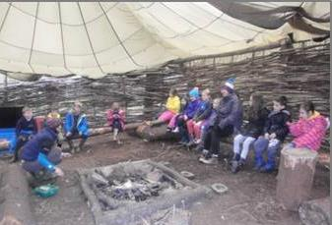
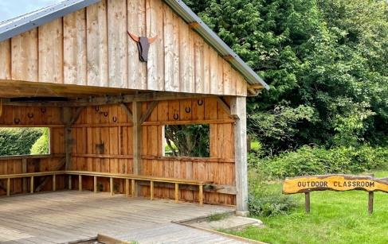
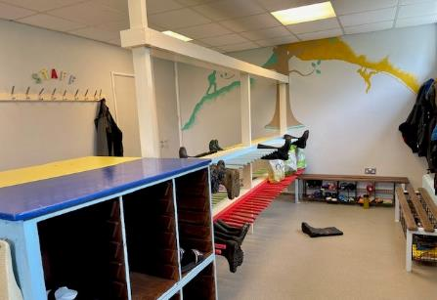
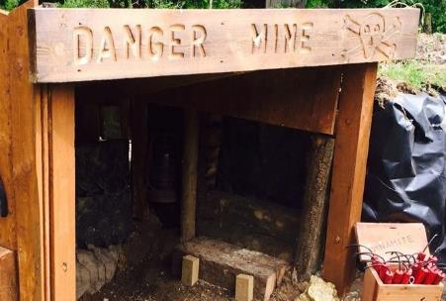
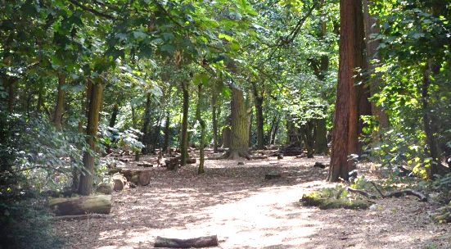
AROUND THE SITE
Notes:
90 private acres, all specialist kit is provided, outdoor classroom, covered bushcraft available, indoor classrooms available.

Slide 6
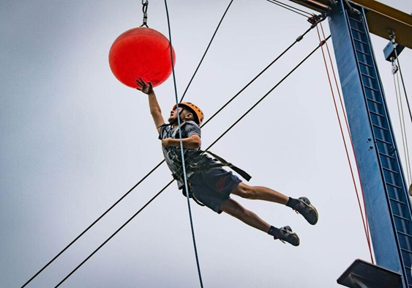
Exciting challenges…
Notes:
What the young people see is…

Slide 7
… in memorable places
Notes:
To make the experience stick. It’ll be memorable.

Slide 8
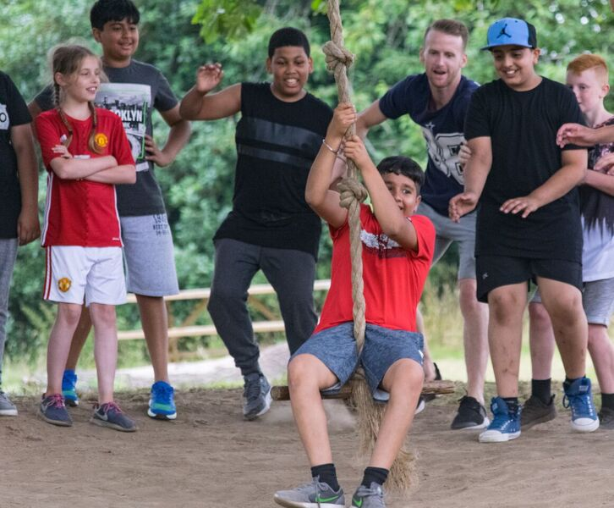
And time to play.
Notes:
Important time for relationships to develop

Slide 9
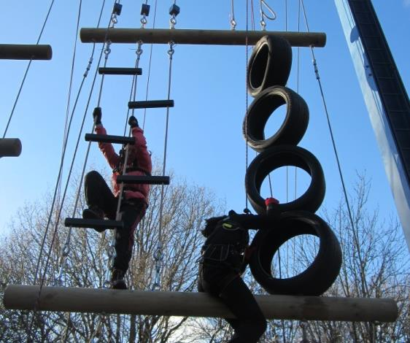
ACTIVITIES
Activities at the centre are about adventure, challenge, exploration, discovery and learning through experience.
We make full use of the beautiful 90 acre ancient woodland
Activities can include:
High ropes course
Climbing wall/abseil
Bushcraft skills and shelter building
Night walk and campfires
Orienteering / Geo caching
Underground mine
Archery
Team confidence building games
We include structured free time; this is a great chance for relationships develop.
Notes:
Activities tailored to suit the children and the conditions.

Slide 11
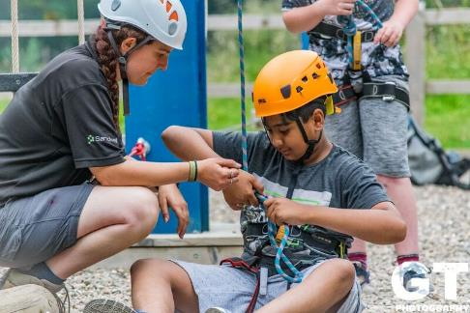
LEARNING
Whether it’s delivering high quality outdoor activities or simply learning through staying away from home and having fun, the Frank Chapman team help every young person achieve more than they ever expected.
We are specialists in residential experiences, and believe passionately in its value.
Tailored Programmes
Every visit is unique. The team work with school and the pupils to shape an exciting, fun, and meaningful visit to Frank Chapman.
Group sizes are 12 students to 1 Frank Chapman tutor supported by school staff.
Notes:
Tutors have the technical skill to make the most of the environments that they work in, and the soft skills to help young people – often quite anxious young people at some stage – to achieve more than they ever expected.

Slide 12
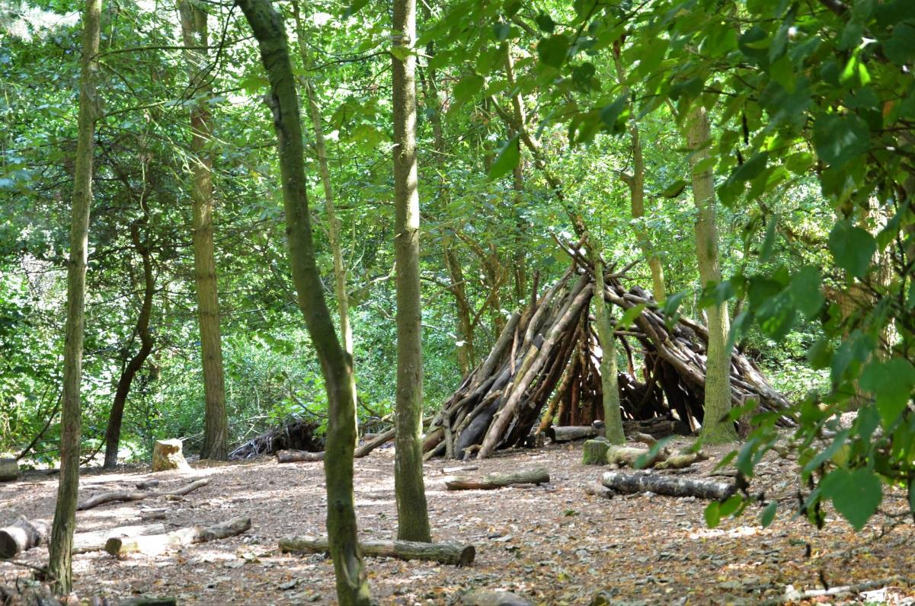
We have seen a real change in the progress and achievement of our children. Their confidence has increased exponentially. This has translated in the classroom into a better attitude for learning and greater confidence in taking part in whole class activities.
Assistant Headteacher - Staffordshire

Slide 13
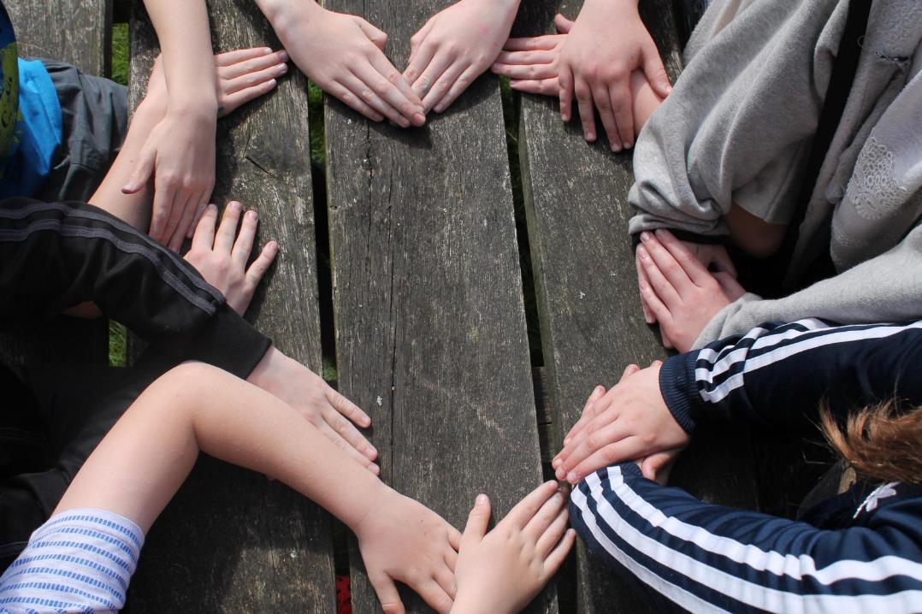
To watch my students transform before my eyes into a new version of themselves - that was amazing!
Assistant Headteacher - Sandwell

Slide 14
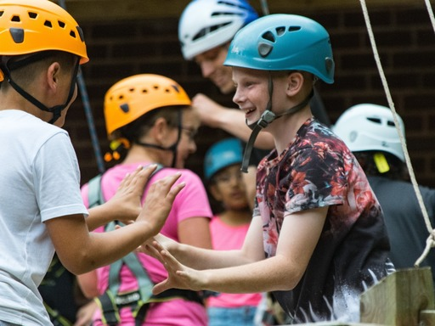
WHY GO TO FRANK CHAPMAN?
A YOUNG PERSON’S PERSPECTIVE
Try out exciting activities like climbing, geocaching and building fires.
Explore an amazing new place
Make new friends and get to know your classmates even better
It’s an adventure! Go beyond your comfort zone and be open to new experiences
Develop skills, discover passions, boost confidence

Slide 15
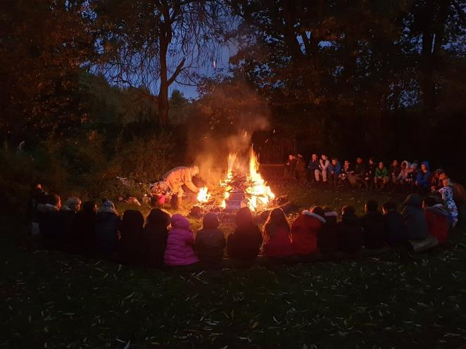
WHY GO TO FRANK CHAPMAN?
A TEACHER’S PERSPECTIVE
Everyone who stays at Frank Chapman Centre gets a warm welcome and the centre soon becomes a home away from home
Develop independence & critical thinking skills
Trying new things and sticking at them
Boost cohesion and sense of belonging
All inclusive – no hidden extras
School and centre staff work as one team to provide the best experience
Notes:
Relationships develop. They get to recognise things within the children that you don’t get to see in any other setting or context.

Slide 16
THE EVIDENCE
LEARNING AWAY – BRILLIANT RESIDENTIALS
Compelling 5 year research that shows a residential experience can:
Improve students’ engagement with learning
Support students’ achievement
Improve resilience, self-confidence & wellbeing
Smooth transition
Notes:
Plus relationships.

Slide 17
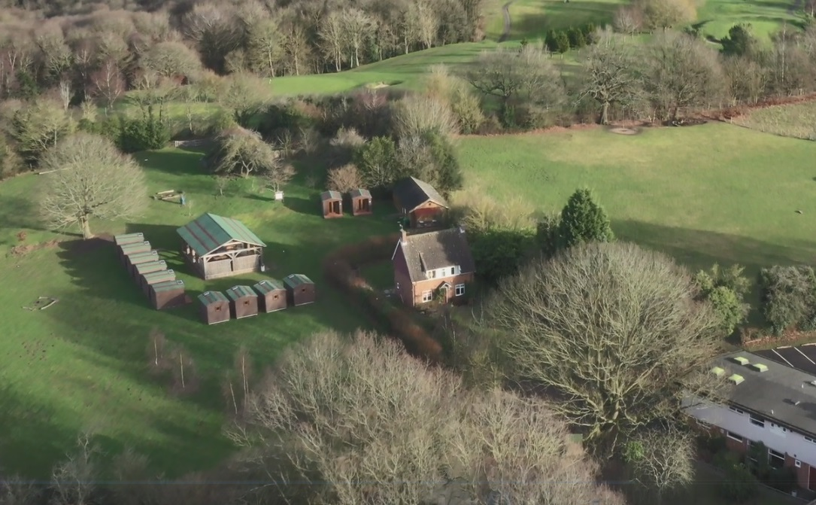
Notes:
The pods area.

Slide 18
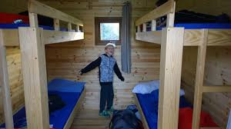
SLEEPING
We have 40 beds in comfortable glamping pods
Each pod sleeps 4 pupils
You’ll have sole use of the pods and dining area
Showers and toilet facilities are nearby
Teacher pods are nearby and centre staff are on hand to provide 24 hour on-site support.
Flood lights and door alarms available

Slide 19
Notes:
Around Orchard village, including loos.

Slide 20
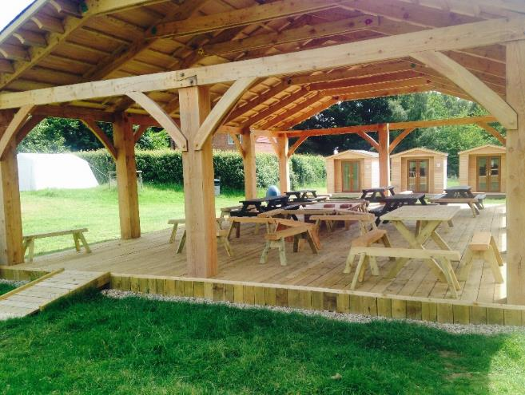
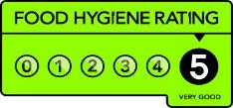
FOOD GLORIOUS FOOD
Home cooked food and cakes!
We cater for all dietary requirements
Plenty of choice and variety
Example meals:
Chicken tikka curry with rice & naan
Sausage with mash & veg
Fish fingers & chips
Meatballs / Bolognaise pasta
Jacket potato option with salad

Slide 21
WE CAN’T WAIT TO SEE YOU!
sandwellresidentials.co.uk

